Slide 1
HyperDesk 1.0
Senior Project Introduction
Team Members: Rachelle Tobkes, Daniel Alvarez
Product Owner: Pia Celestino
Instructor: Masoud Sadjadi
School of Computing and Information Sciences Florida International University

Slide 2
Problem Definition:
Problem:
Many individuals such as freelancers are working from home without a professional space to meet potential clients or to conduct efficient work.
Similarly, many office buildings in populated work hubs are left with unfilled offices or desks, causing owners to lose potential earnings.
Existing System
ShareDesk, LiquidDesk, DeskSurfing
Limitations:
Do not provide users with the freedom of naming their own price.
2

Slide 3
Project Management
3

Slide 4
Requirements: User Stories
Implemented User Stories
1. Login to the System
2. Register for the System
3. Logout of the System
4. Search for Office Space
5. Review/Rate Office Space
6. View Office Space Reviews
7. Make an Offer
8. Filter Search Results
9. Accept/Decline Offers
10. Rent Now
11. Edit Profile
12. Message User
13. Save Credit Card
14. Set Up Bank Account
15. List Office Space
16. View Office Space.
17. Forget Password
4

Slide 5
Requirements: Use Cases
5

Slide 6
Requirements: Sequence Diagram
6

Slide 7
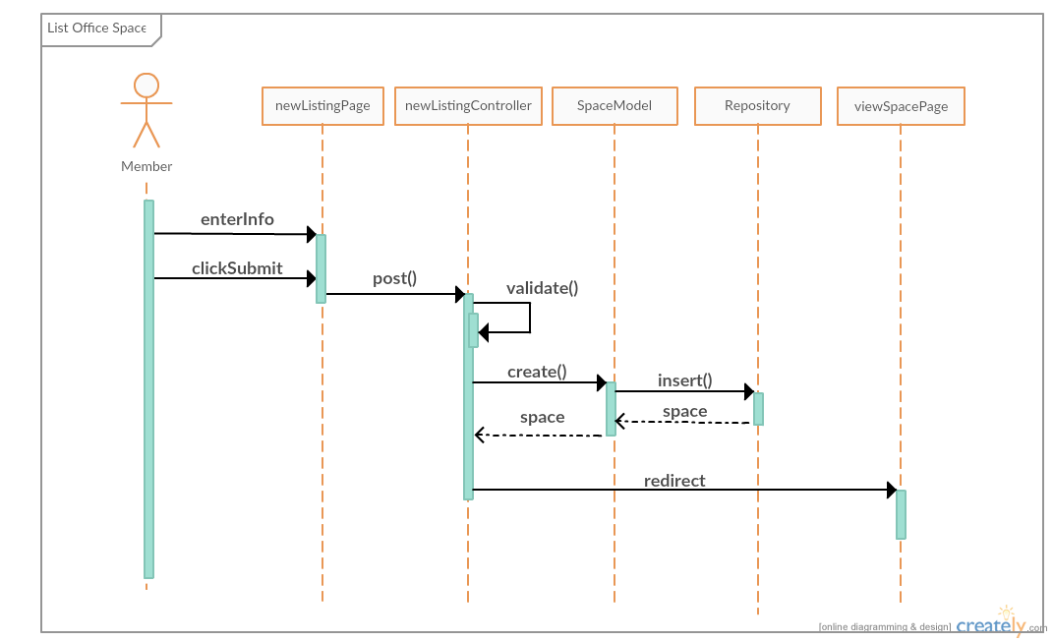
Requirements: Sequence Diagram
7

Slide 8
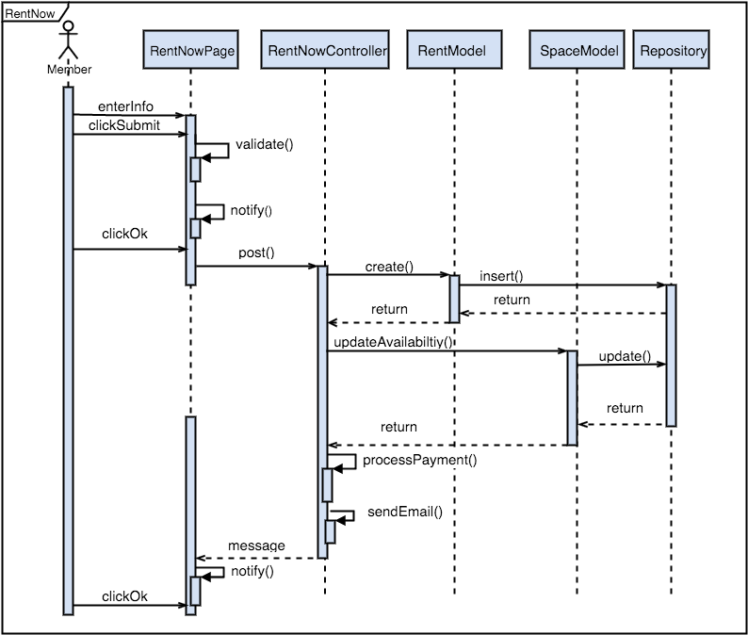
Requirements: Sequence Diagram
8

Slide 9
System Design: Architecture
Client Server
Model View Controller (MVC)
9

Slide 10
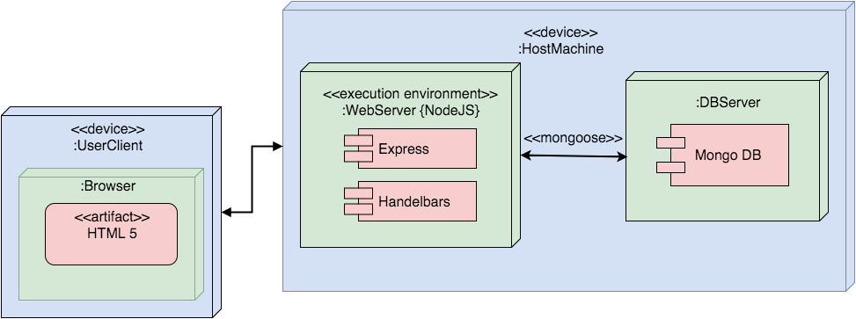
System Design: Deployment
10

Slide 11
System Design: Persistent Data
11

Slide 12
Security/Privacy
Email Verification
Upon registering, user receives verification e-mail
User must verify e-mail within 48 hours
Password Encryption
Bcrypt Node.js Library
Unique and randomly generated salt for each password
10 rounds
Processing Payments
Stripe API
Save secured tokens in the database
12

Slide 13
Minimal Class Diagram
13
Notes:
Design Patterns:
Dependency Injection
Middleware
Singleton

Slide 14
Main Algorithm
How the hours are stored in the database
Object with dates as the keys and an array of the unavailable hours as the values
{ 04/15/2016: [10:00 AM – 11:00 AM, 12:00 PM – 1:00 PM], 04/16/2016: [5:00 PM - 6:00 PM]}
14

Slide 15
Test Suites and Test Cases: (Sunny Day)
Purpose:
To test the functionality when the user reviews an office space with a star rating selected and a written review.
Precondition:
The user should have access to the application
The user should be logged into the system
The user should be on the review page for an office space
Input:
Star selected: 4
Review: This office space was the best one I’ve ever rented!!
Expected Output:
The user is redirected to the office space page and their review is visible.
15

Slide 16
Test Suites and Test Cases: (Rainy Day)
Purpose:
To test the functionality when the user attempts to leave a review without selecting a star rating.
Precondition:
The user should have access to the application
The user should be logged into the system
The user should be on the review page for an office space
Input:
Review: This office was terrible!!!! There was no WIFI!!!
Expected Output:
The system displays “Please select a rating” to the user.
16

Slide 17
Summary
HyperDesk 1.0 is a platform used to facilitate office space rentals.
Unlike other existing websites, HyperDesk allows users to name their price
Thank you!
17

